Slide 1
House Prices-Advanced Regression Techniques
Zijian Wang

Slide 2
Agenda
Problem Definition
Challenges and Importance.
Interesting solutions
My solution

Slide 3
Problem Definition
1640 house information from Ames, lowa
Dataset: Project description,submission sample,train and test
79 features including index Id, and other features.
The target variable in train is the SalePrice
Final Score: RMSE

Slide 4
What is the challenge?
Why is it important?

Slide 5
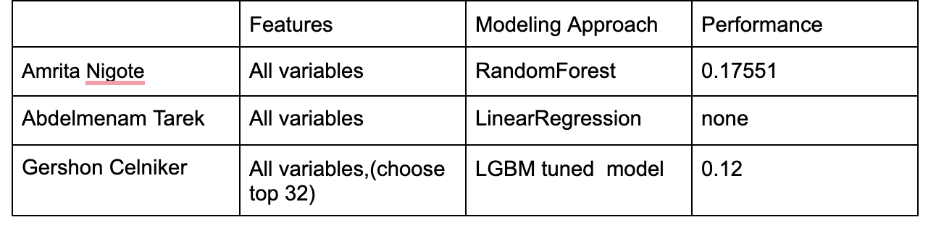
Three solutions

Slide 6
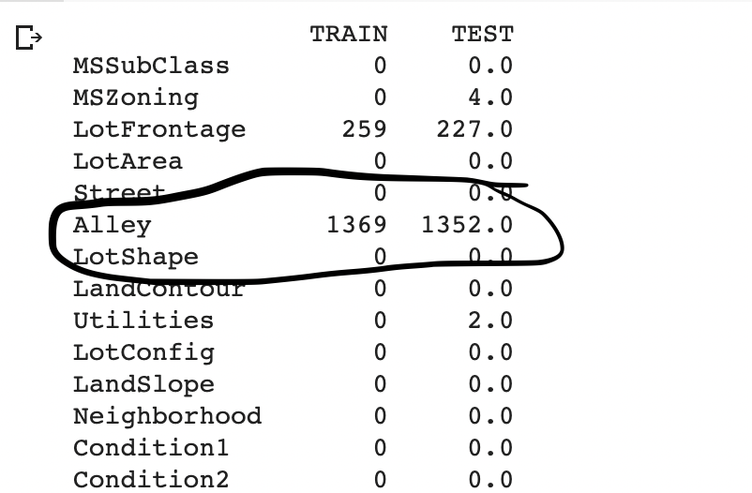
My solution
Dropped columns with over 80% missing stats
Fill all missing value with 0 and ‘none’ dummies
Transfer all categorical variable to dummies
Split train.csv data to train and test with test size=0.3
KNN regressor with K(1-20)

Slide 7
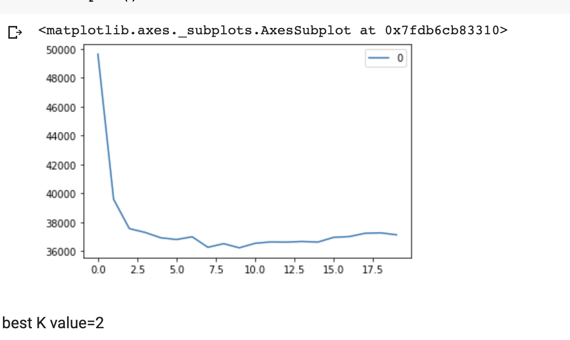
RMSE, K value elbow plot
Best k value=2
Neither overfit nor underfit
Future work: Neural network

Slide 8
Thanks!

